Slide 1

Electric Vehicle Battery Monitoring and Fire Protection
Presented By:
1. E1-80381 Satish Kumar
2.E1-80408 Ashish Bharadwaj
3. E1-80414 Poonam Devkar
4.E1- Ayisha Khan

Slide 2
Electric Vehicle Battery Monitoring and Fire Protection
Preface
Introduction
Block Diagram
Hardware Requirements
Software Requirements
References

Slide 3
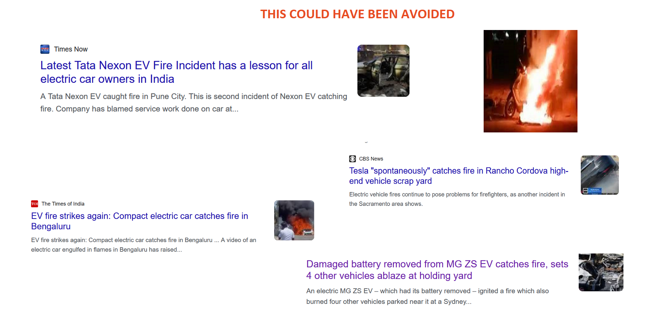

Slide 4
Introduction
Electric vehicles (EVs) are becoming more popular because they're better for the environment. But the batteries in
EVs need special care to make sure they work well and don't cause problems like fires. That's where our project
comes in. We've made a smart system that uses special technology to keep an eye on EV batteries and protect them.
This way, EVs can be safer and more reliable.
Our project focuses on the critical areas of battery management and fire protection, utilizing innovative
components like STM32 microcontrollers, Free RTOS, and the CAN protocol. By continuously monitoring battery
health and detecting potential fire hazards, we aim to make EVs not only more reliable but also safer for everyone.

Slide 5
Project Objectives
Real-time Battery Monitoring
Fire Protection
Integration of FreeRTOS, STM32 and CAN Protocol
IoT Server for notification of fire accident.

Slide 6
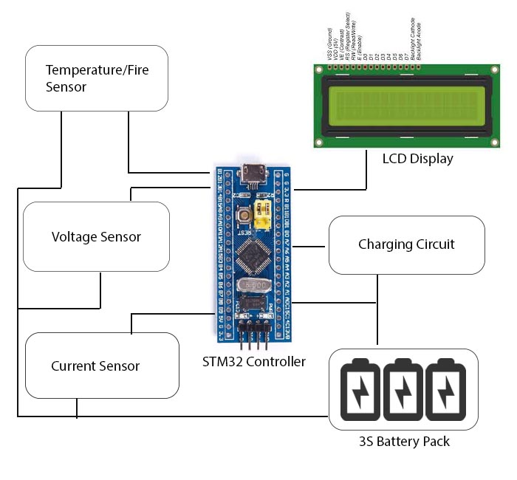
Block DIagram

Slide 7
Hardware Requirements
STM32 Controller
Temperature Sensor
Voltage Sensor
Current Sensor
LCD Display
Li ion Battery
Regulatory Circuitry
Switches
Relay
LED’s
PCB Board
Resistors
Capacitors
Transistors
Cables and Connectors
Screws and Bolts
DC motor

Slide 8
Software Requirements
STM32Cube
FreeRTOS
MQTTRoute – Message Queuing Telementry Transport
CAN Protocol for Communication

Slide 9
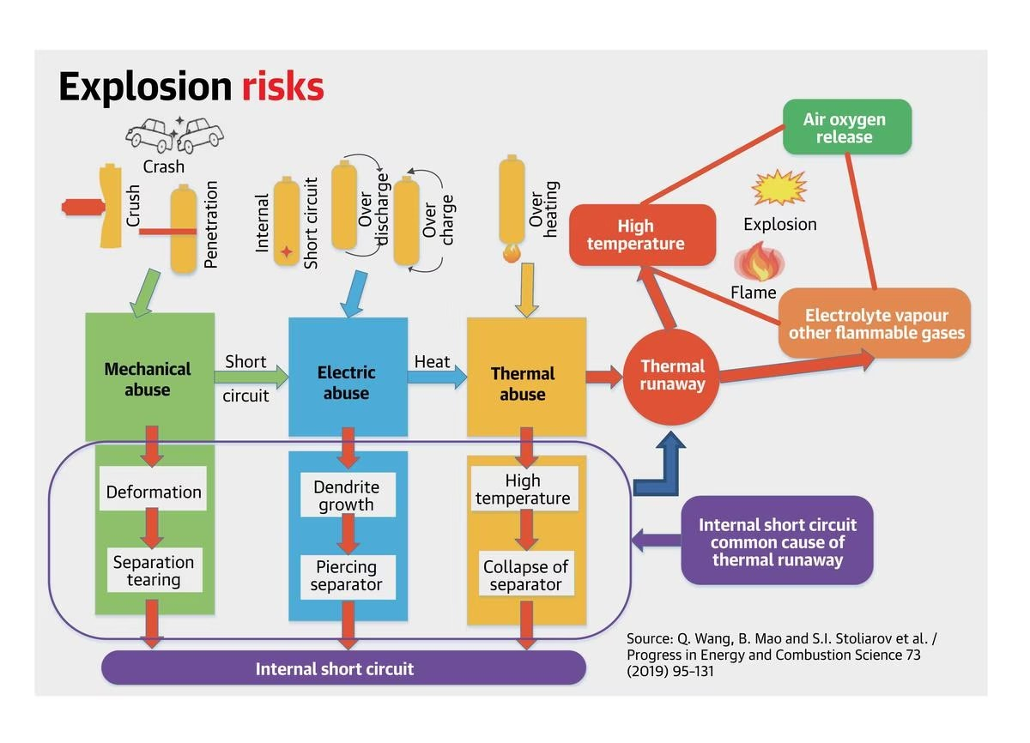
Causes of Fire in EV

Slide 10
Thermal runaway condition
Thermal runaway is a critical and potentially hazardous condition that can occur in electric vehicle (EV) batteries, especially those that use lithium-ion technology. It refers to a self-perpetuating, uncontrollable chain reaction of heat generation within the battery cells, which can ultimately lead to fires or explosions. Here's how thermal runaway occurs in EVs:
Overheating: Thermal runaway often begins with an increase in temperature inside one or more battery cells. This can happen due to various factors, such as high ambient temperatures, overcharging, rapid charging, or manufacturing defects.
Exothermic reactions: When the temperature in a cell rises significantly, it can trigger exothermic chemical reactions within the battery. These reactions release heat and can further elevate the cell's temperature.
Heat propagation: The heat generated in one cell can spread to neighboring cells due to thermal and electrical conductivity within the battery pack. This heat transfer can lead to multiple cells undergoing exothermic reactions.
Venting and gas release: As the temperature continues to rise, gases may be released from the overheating cells. These gases can include flammable and volatile compounds, which can pose a fire hazard.
Thermal runaway propagation: If not controlled, the chain reaction can spread throughout the entire battery pack, causing more cells to overheat and release gases.
Fire or explosion: When the temperature and pressure build up to a critical point, the battery pack can rupture, leading to fires or, in extreme cases, explosions.
To mitigate the risk of thermal runaway, EV manufacturers incorporate various safety features and thermal management systems in their vehicles. These safety measures can include:
Battery management systems (BMS): BMS monitor and manage the temperature, voltage, and state of charge of individual cells, helping to prevent overcharging and over-discharging.
Thermal management: EVs often have cooling systems to regulate the temperature of the battery pack, preventing overheating.
Fire-resistant materials: Some EVs use fire-resistant materials in their battery enclosures to contain and suppress fires in the event of a thermal runaway.
Emergency procedures: Manufacturers provide guidelines and protocols for first responders in case of an accident or fire involving an EV, including procedures for safely dealing with the battery.
While thermal runaway is a concern in EVs, it's essential to emphasize that the risk is relatively low, and modern EVs are designed with multiple layers of safety to reduce the likelihood of such incidents. Moreover, ongoing research and development in battery technology aim to improve the safety of electric vehicles and reduce the occurrence of thermal runaway events.

Slide 11
advantages
Utilizing an STM32 microcontroller, FreeRTOS (a real-time operating system), and CAN (Controller Area Network) for EV battery monitoring and fire protection can offer several advantages for electric vehicles. These technologies provide a robust and efficient platform for managing the complex battery systems in EVs. Here are some advantages:
Real-time monitoring and control:
The combination of STM32 and FreeRTOS enables real-time monitoring and control of the EV battery system. This is crucial for ensuring the safety and optimal performance of the battery.
Enhanced safety:
With the STM32 microcontroller and FreeRTOS, you can implement safety features such as overvoltage and overcurrent protection, cell balancing, and thermal management to prevent hazardous conditions like thermal runaway.
Efficient resource management:
FreeRTOS allows for efficient utilization of system resources, which is vital in EV battery management to ensure accurate data collection, processing, and control.
Multitasking capabilities:
FreeRTOS supports multitasking and allows you to run multiple tasks simultaneously, making it suitable for managing various aspects of an EV's battery system, including communication, temperature monitoring, and voltage control.
Communication and data exchange:
CAN (Controller Area Network) is a robust and reliable communication protocol commonly used in automotive systems. It facilitates data exchange between different components of the EV, including battery management systems, motor controllers, and other critical systems.
Scalability and flexibility:
The STM32 microcontroller family offers a wide range of devices with different processing capabilities, making it scalable for different EV battery systems. You can choose the appropriate STM32 device based on the complexity of your EV's battery management requirements.
Reliable fault detection and handling:
Using STM32, FreeRTOS, and CAN, you can implement mechanisms for detecting faults or abnormal conditions in the battery system and initiate appropriate responses, such as shutting down the system to prevent further damage.
Real-time data logging and analysis:
With STM32 and FreeRTOS, you can log and analyze real-time data from the battery system, which can help in identifying and resolving issues proactively.
Open-source and community support:
FreeRTOS is an open-source real-time operating system with a thriving community, providing access to a wide range of libraries, drivers, and resources for building and maintaining your EV battery management system.
Compliance and safety standards:
Using established technologies like STM32, FreeRTOS, and CAN can help ensure compliance with automotive safety standards, which is essential for EV manufacturers to meet regulatory requirements.

